Slide 1



From Numbers to Verifiable Credentials
The Future of ID Tech
Tanusree Deb Barma
Deputy Director General
UIDAI Technology Centre
PanIIT Bangalore Summit 2026 | 16/05/2026

Slide 2

India had a trust problem
Verifying who someone was slow, costly, and broken.
Notes:
l

Slide 3
Aadhaar was the answer.
Biometric identity, at billion-person scale, built on privacy by design.
Aadhaar Effect
Aadhaar Era
Next Frontier
Passwords and manual ID checks dominated verification across digital and physical spaces. Aadhaar bought it in digital identity verification in India
Aadhaar introduced biometric based 1:1 matching as the primary verification method for identity
Focus now shifts to combating authentication frauds & achieving 130 million verification per day
Aadhaar solved for deduplication of identity in a database by allocating a unique ID
1.43 billion
*As of April 2026
Focus on encouraging the offline verification (create usage of identity sharing through digital offline means as a user preference)
Aadhaar Generated
KYC costs of ~USD 6-9 was reduced to 0.03 USD
173.09 billion
Improve liveness models through continuous training
Created savings worth USD 45 billion since 2013 through Direct Benefit Transfers
Authentications done
Provide sandbox for open dataset testing to help ecosystem to improve models
23.71 billion
89% of adults have access to bank accounts (35% in 2011)
Expand the use to low assurance use cases such as hotel check-ins, event management and police verification
eKYC done
Notes:
l

Slide 4
Big numbers,
but something was still missing.
Physical ID cards continue to be widely used and are vulnerable to spoofing during human eye based verification
Users lose control over their Aadhaar data once it is shared with businesses
Aadhaar API integration for businesses became burdened with extensive compliance requirements
The 2018 Supreme Court verdict restricted Aadhaar usage in private sector use cases, limiting adoption to regulated sectors such as banking, insurance, and telecom
Notes:
l

Slide 5
Our solution to this…
Notes:
l

Slide 6
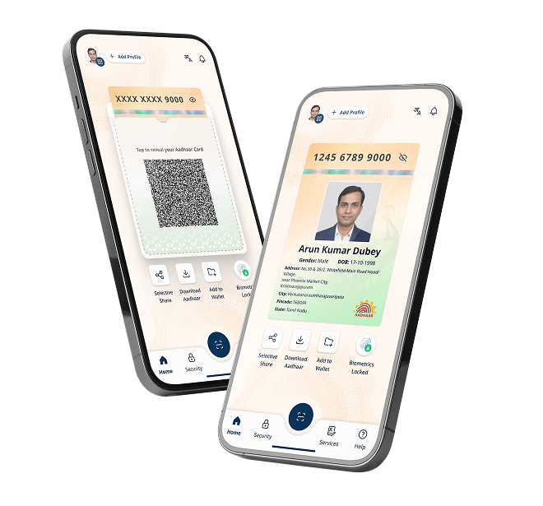

Aadhaar App
Re-imagined Digital Identity
Show
Share
Verify

Slide 7
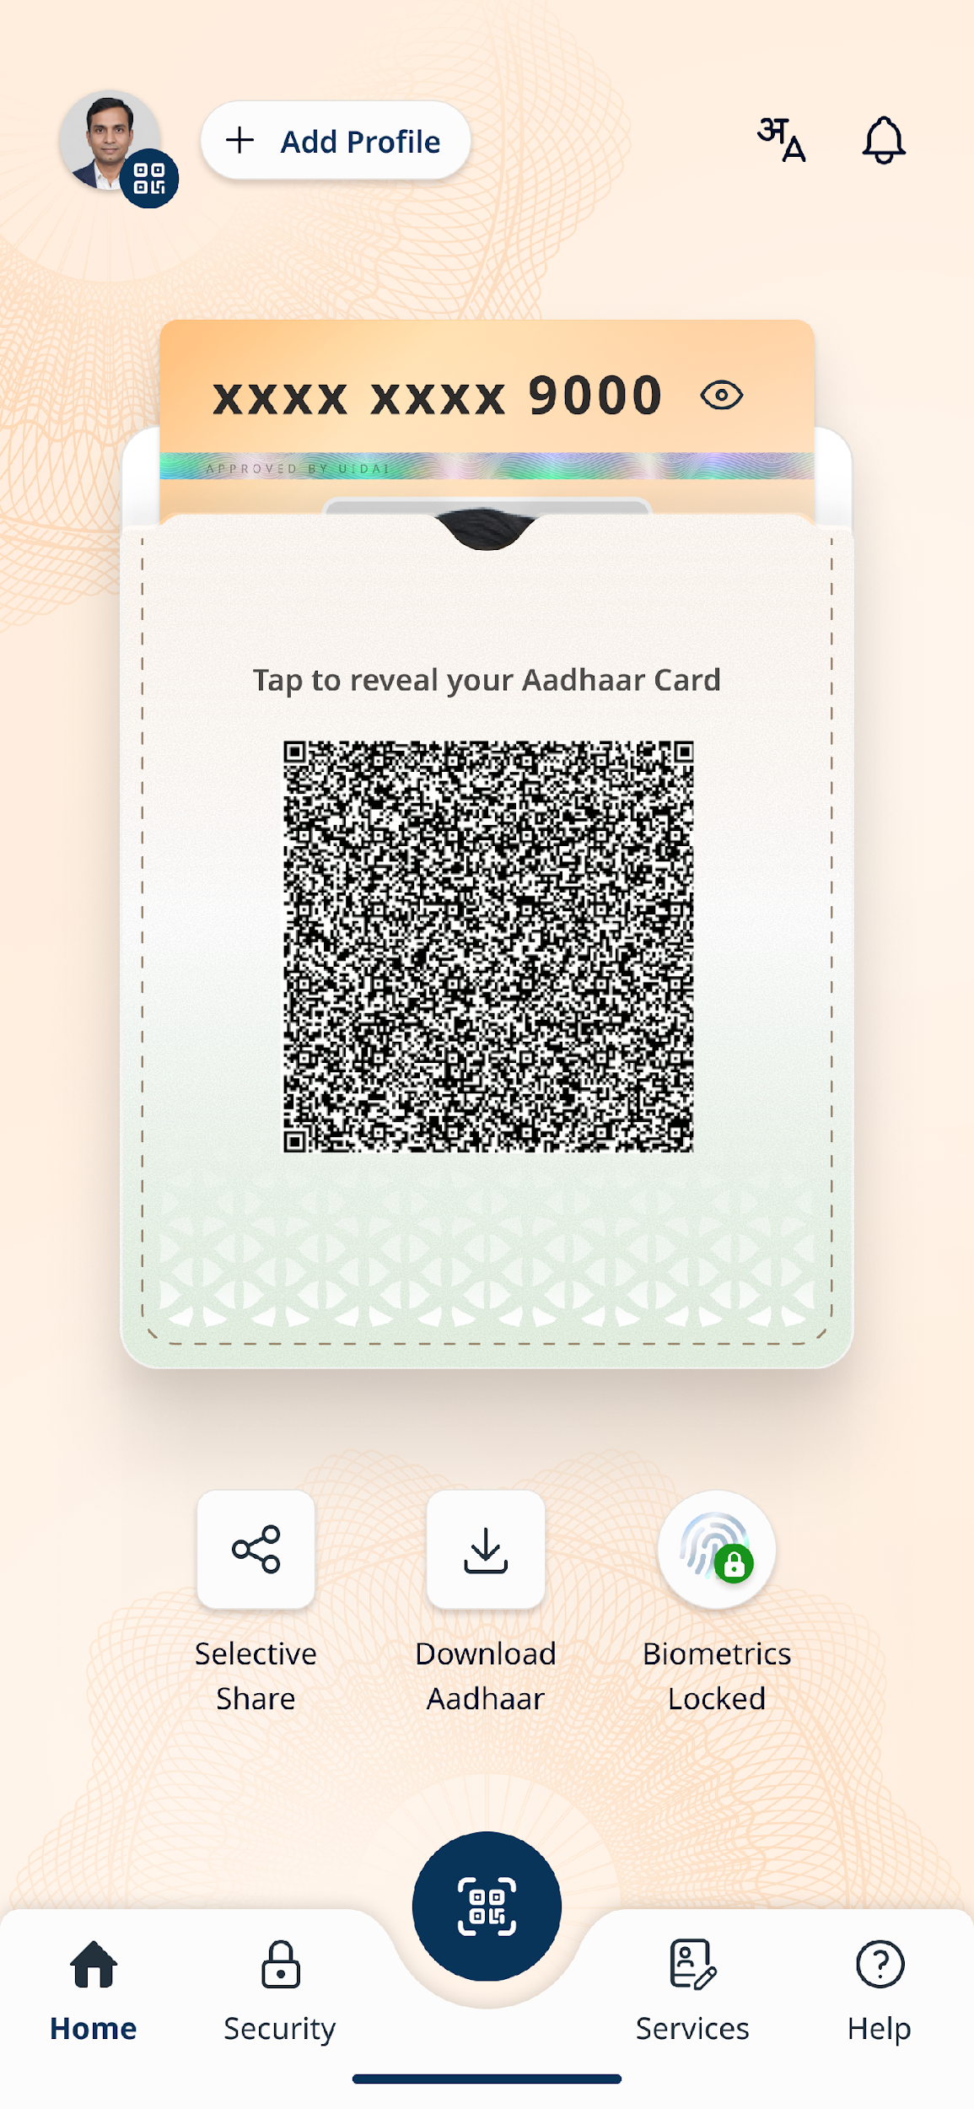
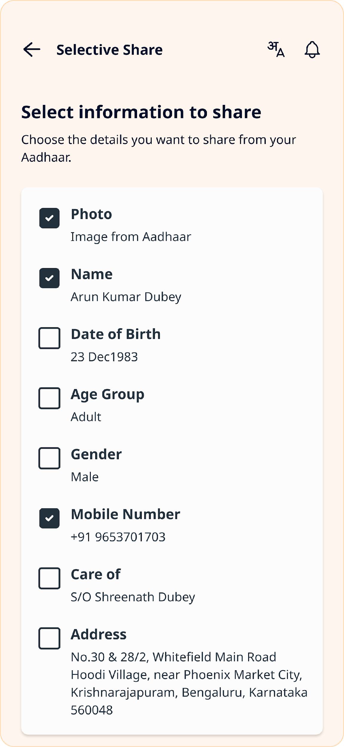
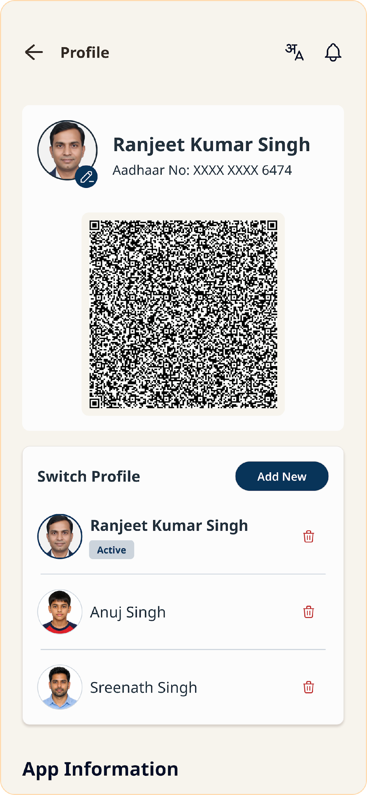
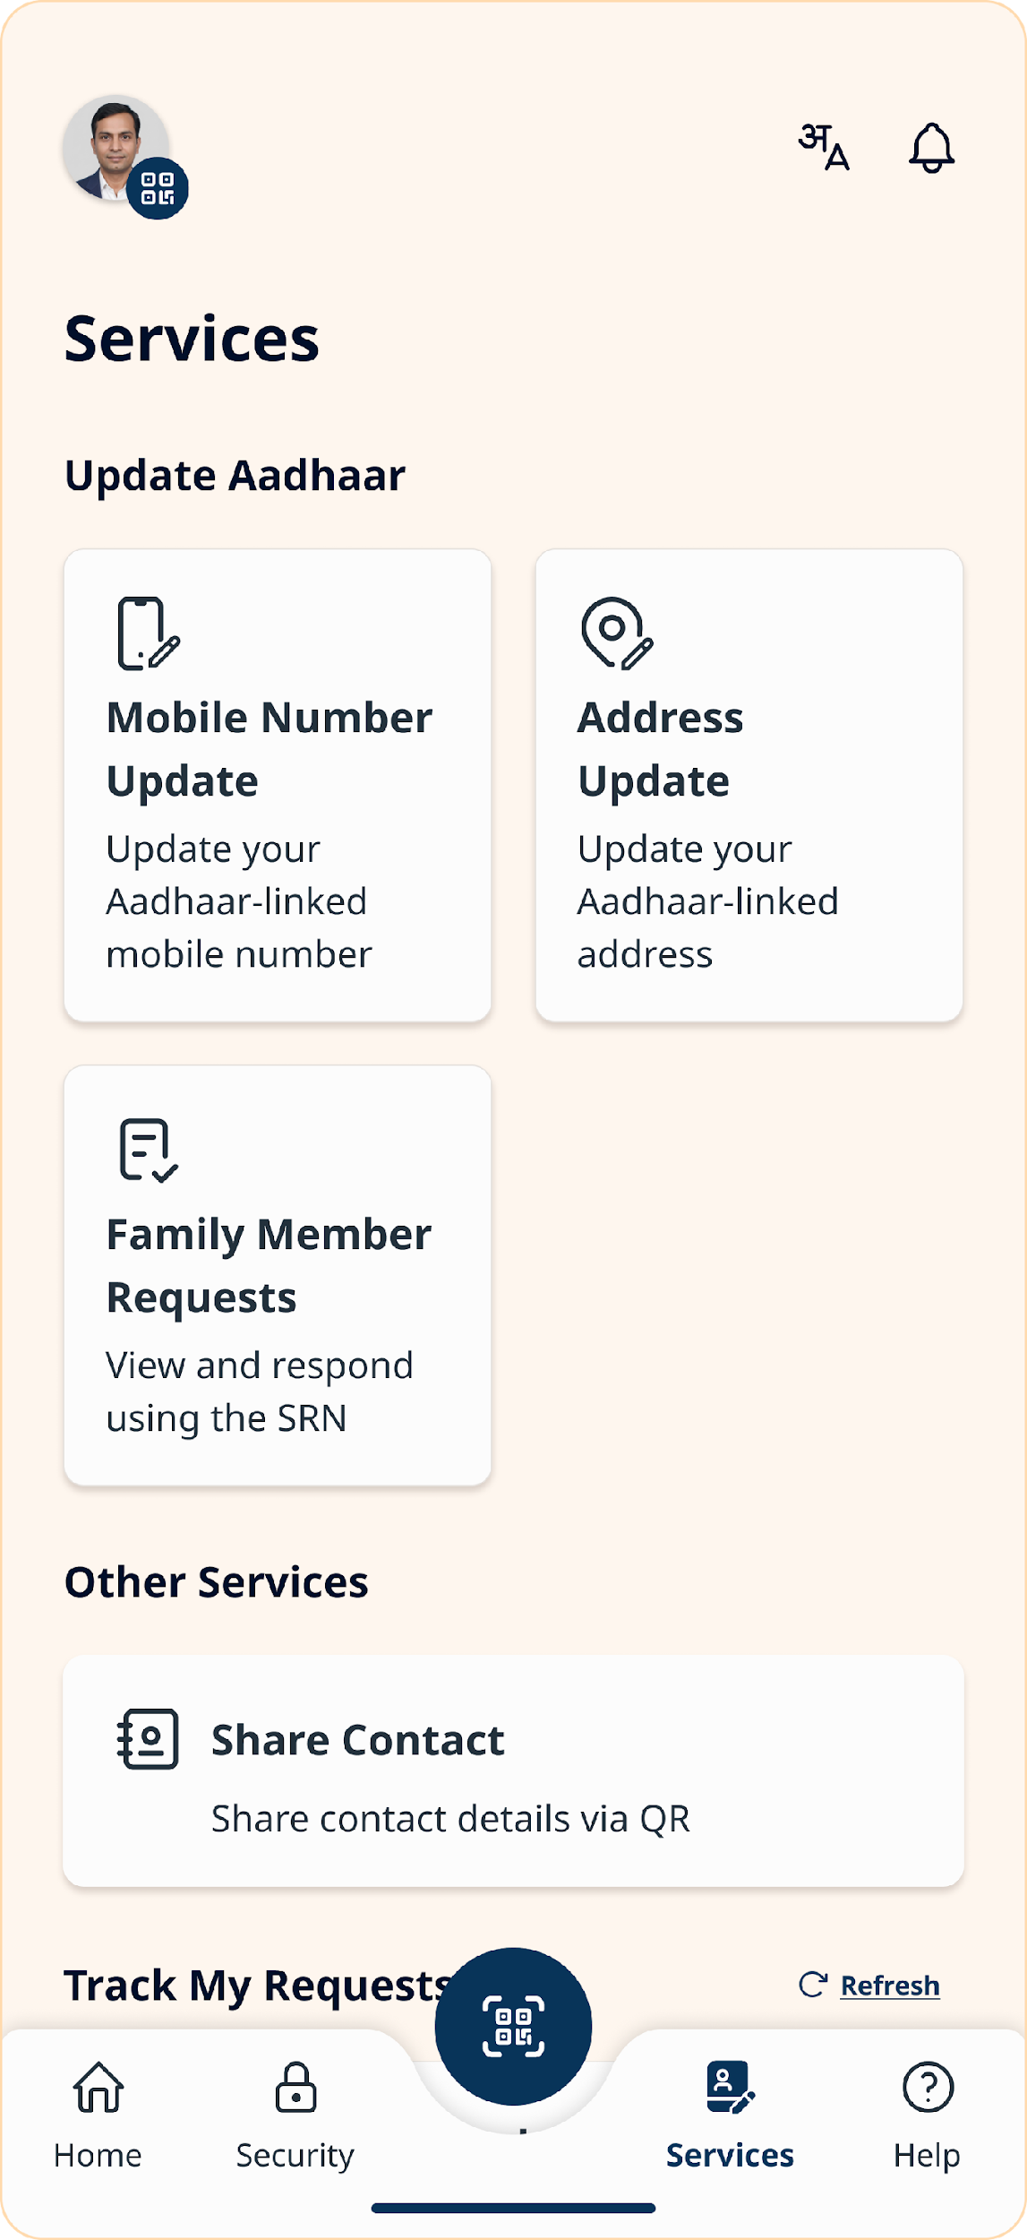
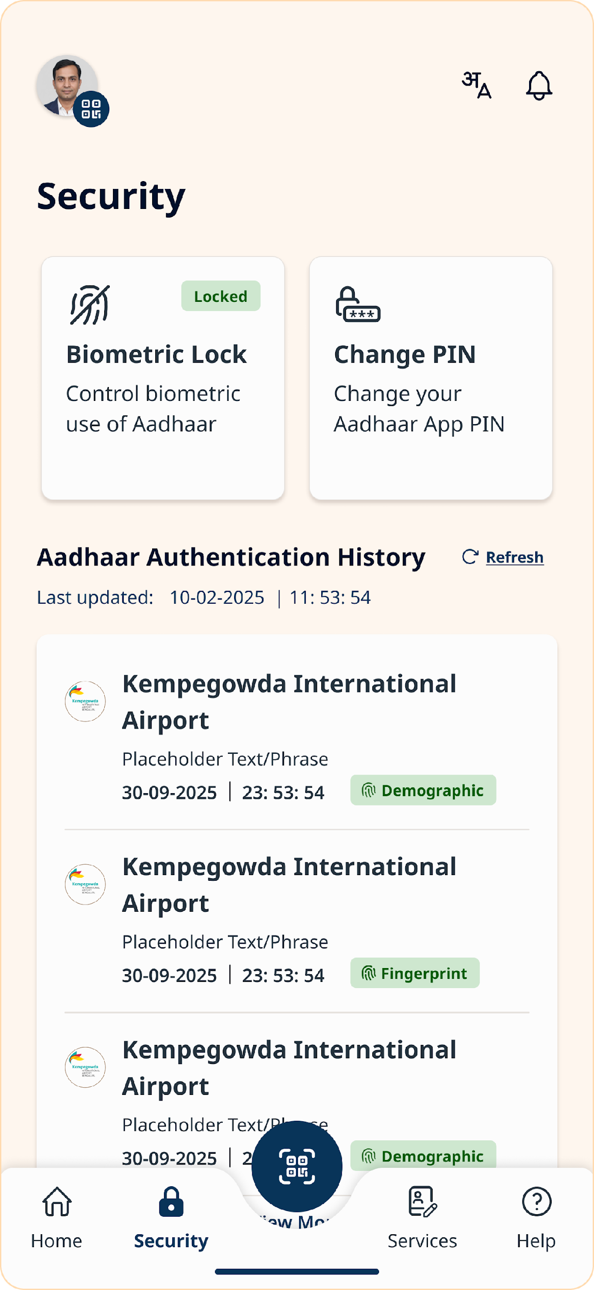
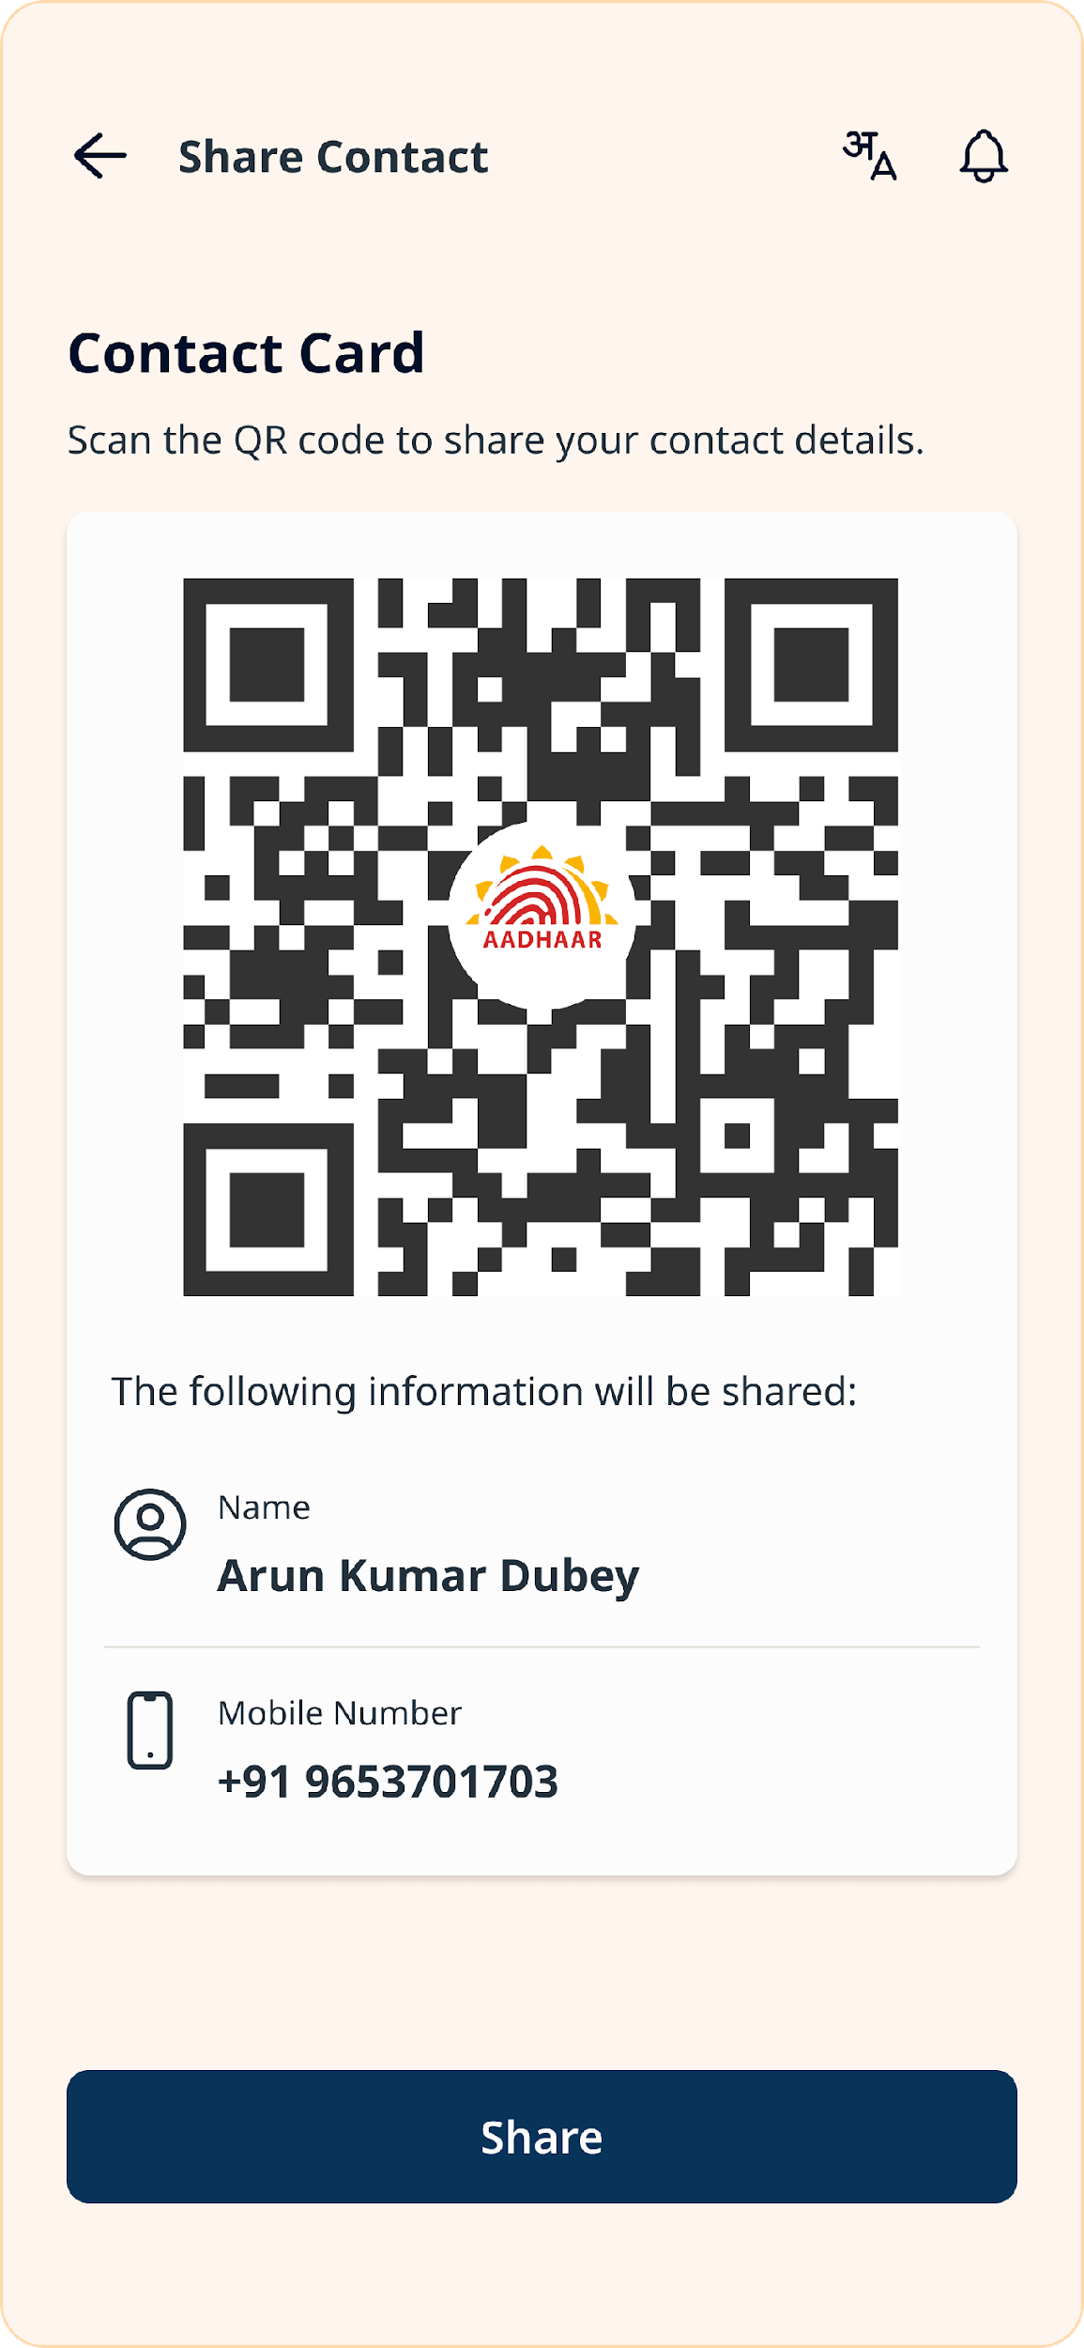
Functional
Aadhaar App is Functional
Notes:
l

Slide 8
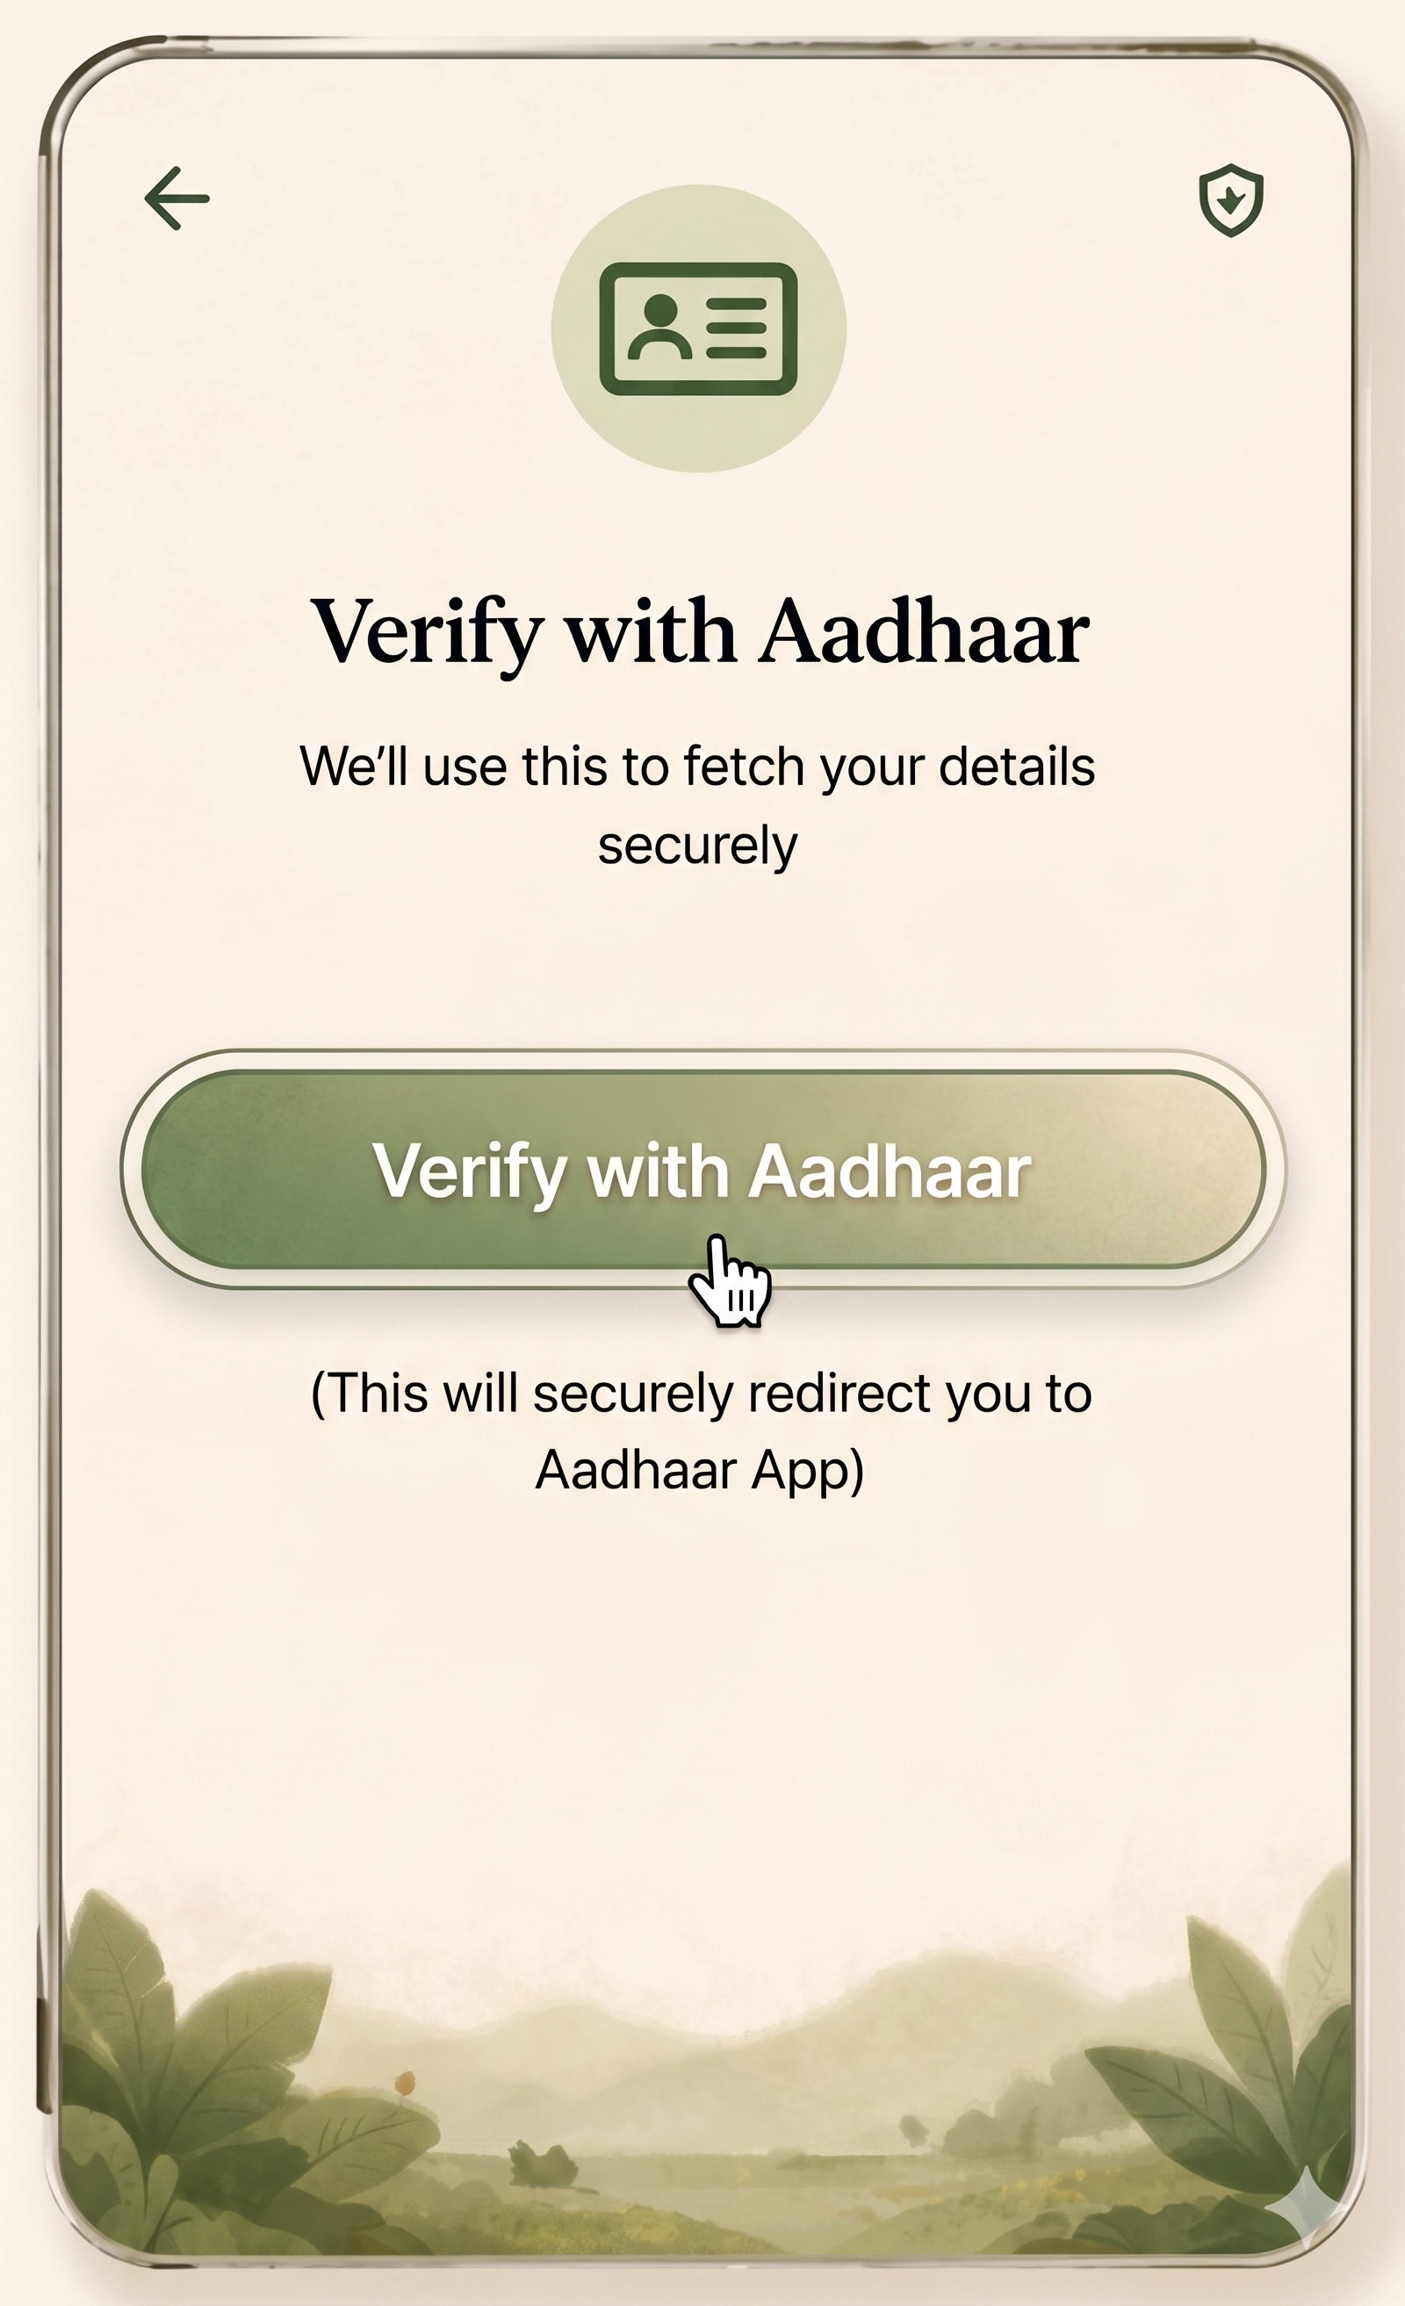
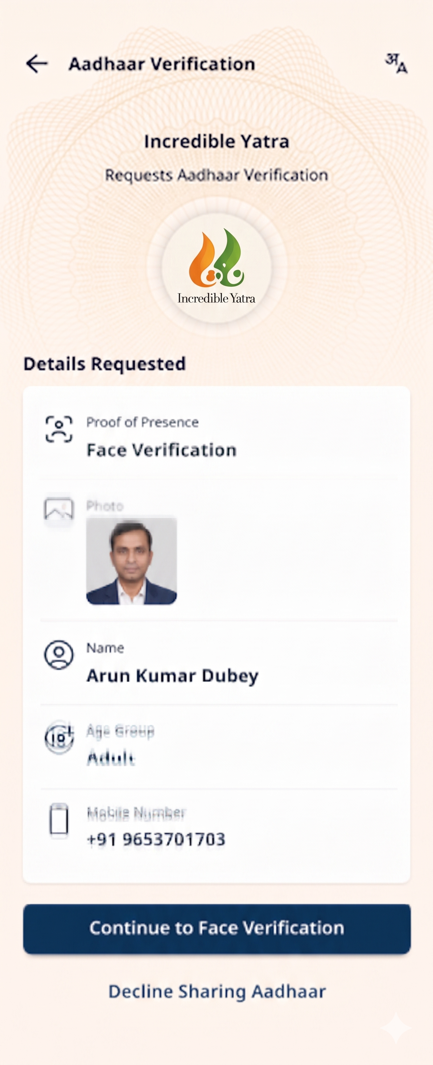
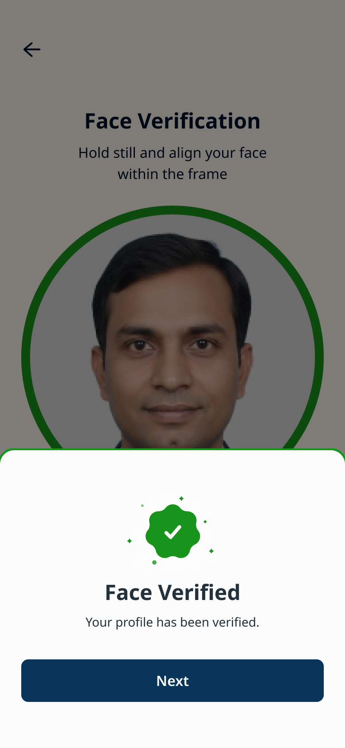
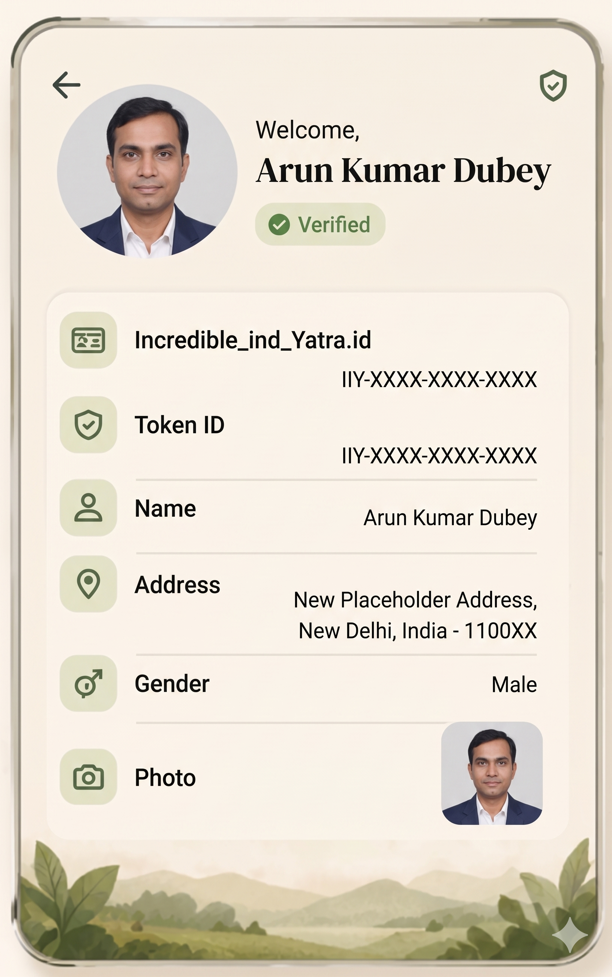
Aadhaar App
Yatra ID through Aadhaar VC
1. Make an Intent call from Incredible Yatra App to Aadhaar App
2. Redirects to Aadhaar App for identity verification
3. User Approves the request from Incredible Yatra App
4. User is redirected to Incredible Yatra App
Notes:
l

Slide 9
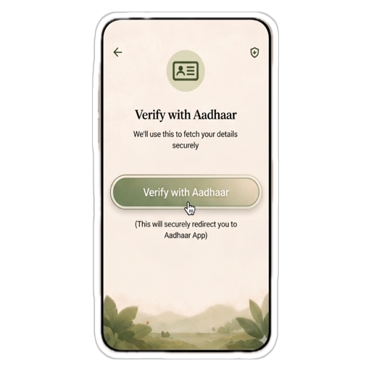
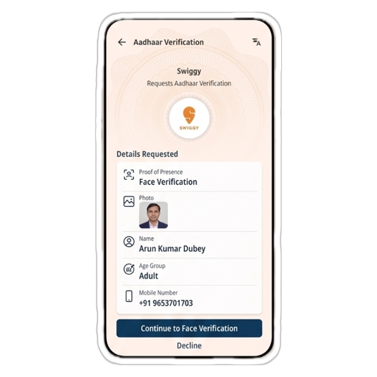
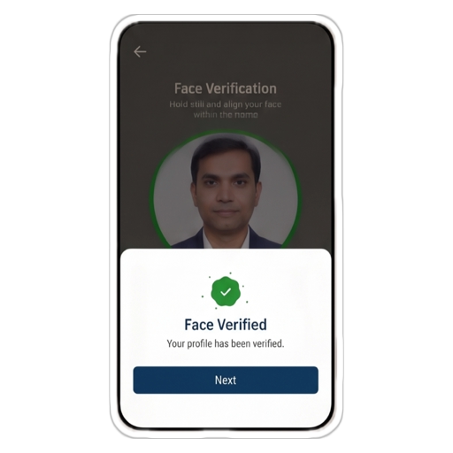
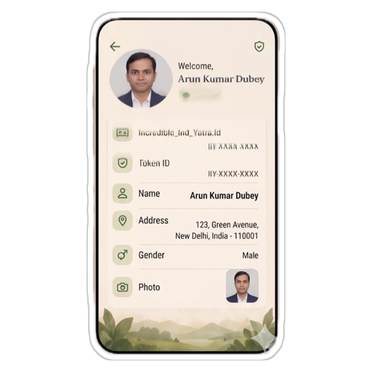
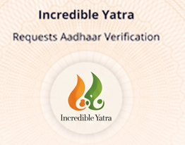
Aadhaar App
Yatra ID through Aadhaar VC
1. Make an Intent call from Incredible Yatra App to Aadhaar App
2. Redirects to Aadhaar App for identity verification
3. User Approves the request from Incredible Yatra App
4. User is redirected to Incredible Yatra App
Notes:
l

Slide 10
Functional
Scan QR Code
to verify
Peer to Peer verification which works offline

Slide 11
Functional
Minimum Data.
Maximum Privacy.
Selective sharing

Slide 12
Functional
Multiple profiles,
One App
Designed for families and shared devices

Slide 13
Functional
In Minutes,
Zero Visits.
Address and existing mobile number updates

Slide 14
Functional
Your Aadhaar.
In Your Control.
Biometric Lock/Unlock & Authentication History

Slide 15
Functional
A Simple Way
to Share Contact Details
Contact cards

Slide 16
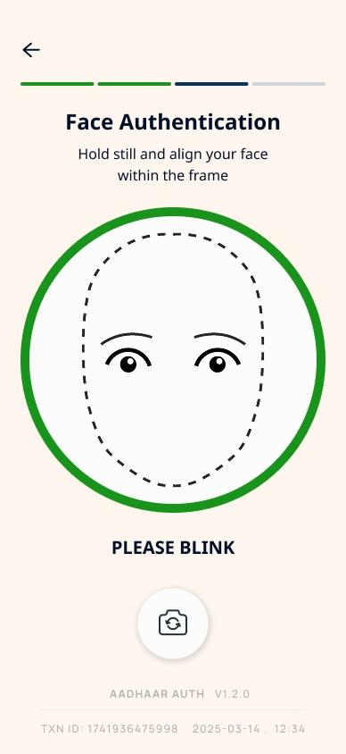
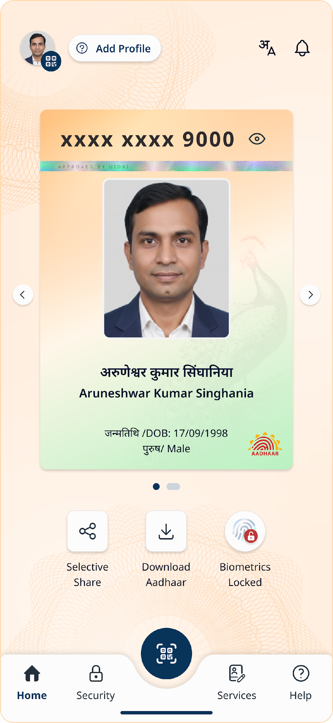
Aadhaar App is A Platform
Integrated
Application
Face
Verification
Verifiable Credentials
Notes:
l

Slide 17
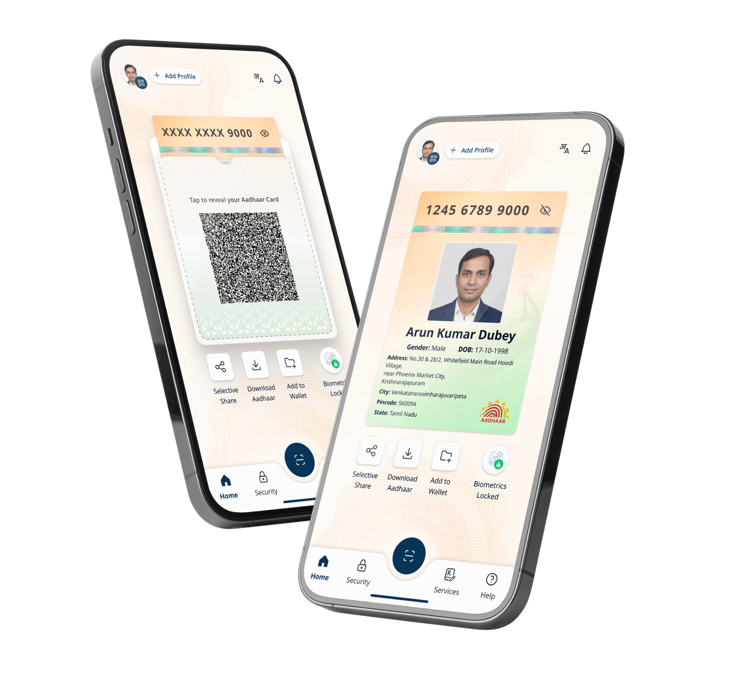




Aadhaar based Verifiable credential ecosystem
A Platform
21 million credential downloads in 3 months
110 RPs use wallet-based VC sharing
Issuer Services
Relying parties
Credential Issuance
Finance
Trust Registry
Wallets
Hospitality
Dispute Resolution
All identity verfication
Live
Live
Coming soon
Notes:
l

Slide 18
Aadhaar based Verifiable credential ecosystem
25 million+ credential downloads in 3 months
125+ RPs use wallet-based VC sharing
Wallets
Live
Live
Coming soon
Issuer Services
Relying parties
Credential Issuance
Finance
Trust Registry
Hospitality
Dispute Resolution
Social Media
Notes:
l

Slide 19


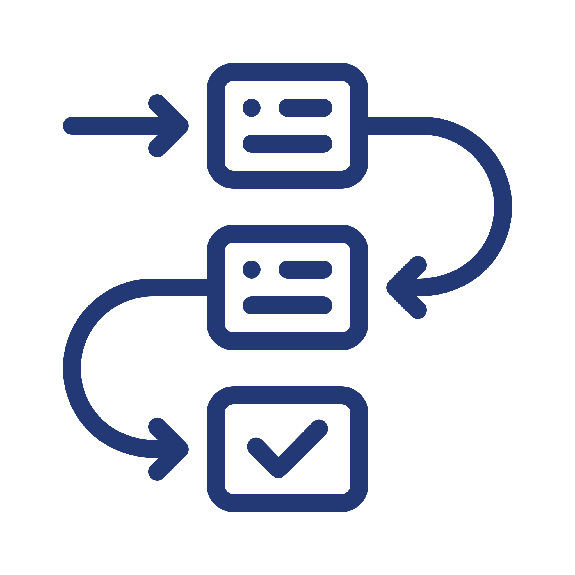

Aadhaar is ready for interoperability with Aadhaar’s Verifiable Credentials
A Platform
Empower users
Aadhaar VC allows selective disclosures of PII Data through SD-JWT, mDOC data formats - ensuring privacy and portability.
Wallet Ecosystem
Aadhaar VC is interoperable with wallet which are compliant with Aadhaar guidelines
International Standards for Issuance & Presentation
Aadhaar VC prescribes the use of international standards such as OPENID4VCI, OPENID4VP & W3C DC API (WIP) for Exchange of Aadhaar Credentials
Aadhaar Verifiable Credentials
Zero Knowledge Proof (Under Development)
BBS+ & Longfellow based algorithms for age assurance use case
Notes:
l

Slide 20








A Platform
Catering to diverse use cases
Employees & Gig worker ID Verification
Fintech/BFSI
Hospitality
Social Media
Public Sector & Governance
Event Entry Management
Real Estate
Digital Wallet
Notes:
l

Slide 21
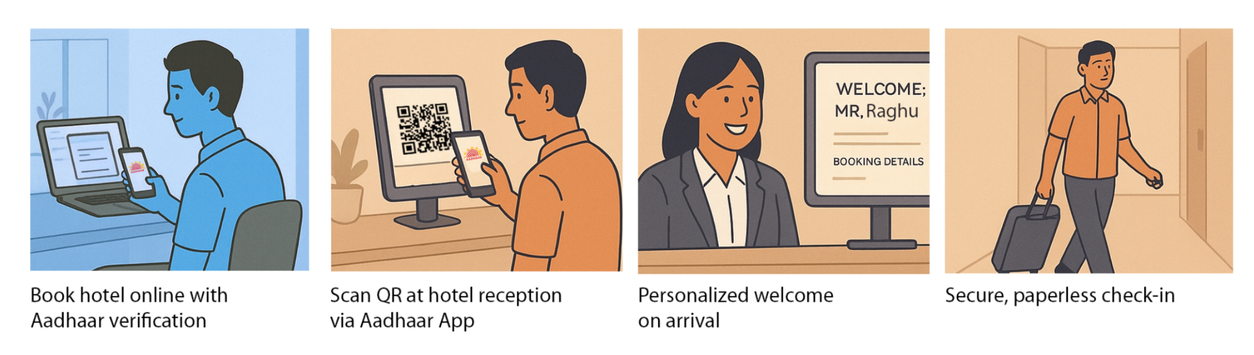
Use Case 01
It replaces the hassle and safety concerns of your aadhaar being copied and kept.
A Platform
Scan QR
At a hotel check-in

Slide 22
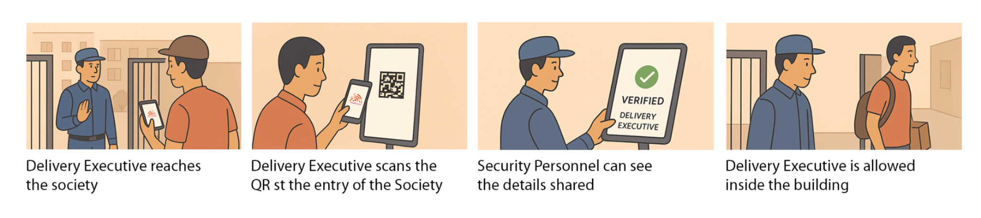
Use Case 02
Verified QR access: only authenticated visitors can enter, eliminating fake IDs and spoofed codes for safer societies.
A Platform
Scan QR
At a security gates in societies

Slide 23
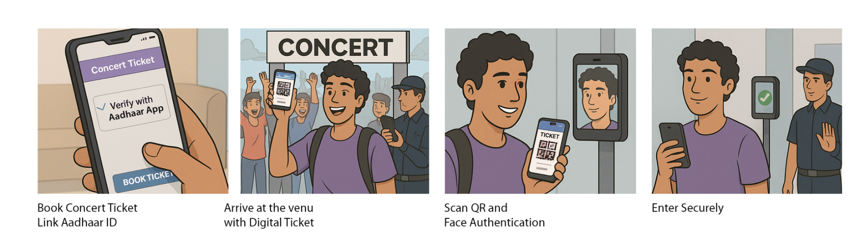
Use Case 03
Zero knowledge proof at concert entries-
The security doesn’t even need to know your name.
A Platform
Bluetooth/NFC
At a security gates in concerts & events

Slide 24
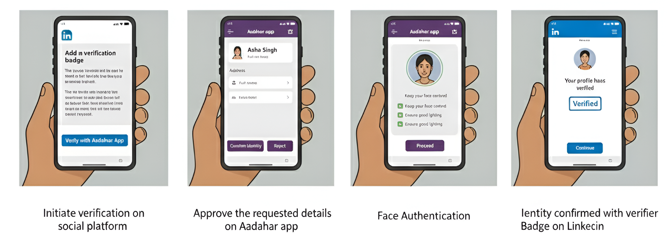

Use Case 04
Verify your social media profile with Aadhaar for a trusted identity badge.
Identity confirmed with verifier badge on Social Media
A Platform
App to App Intent
Social Media Profile Verification

Slide 25
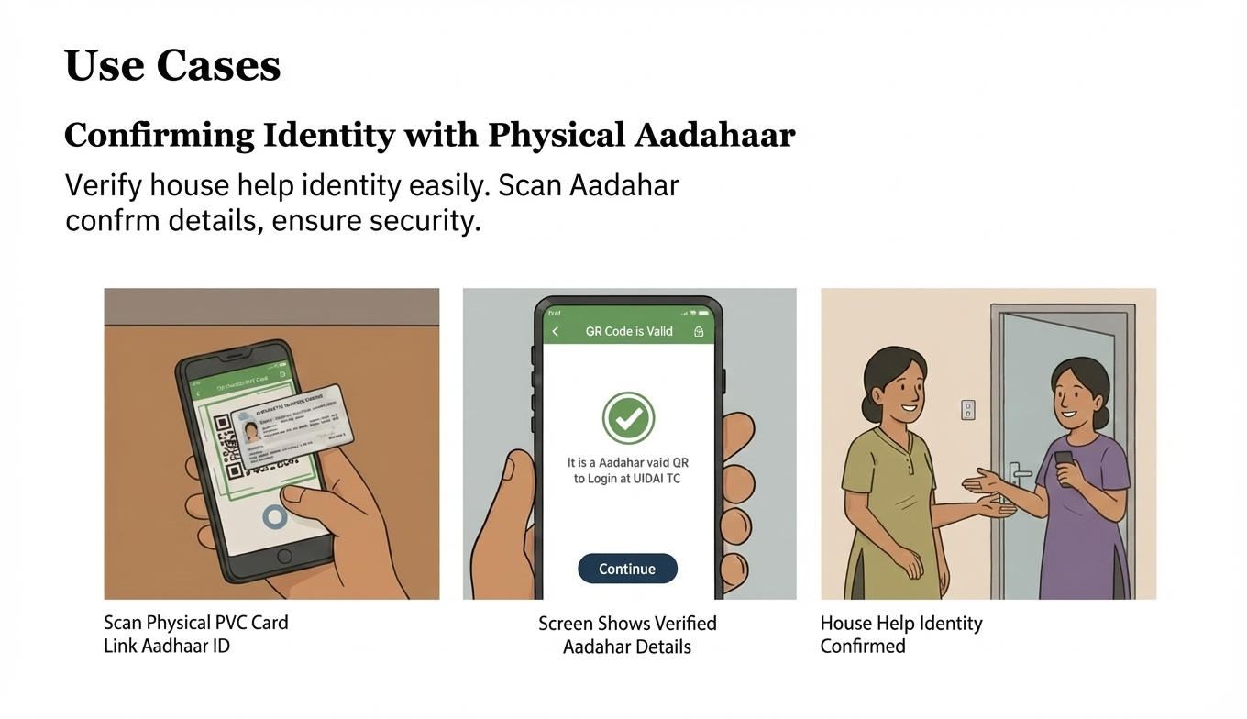
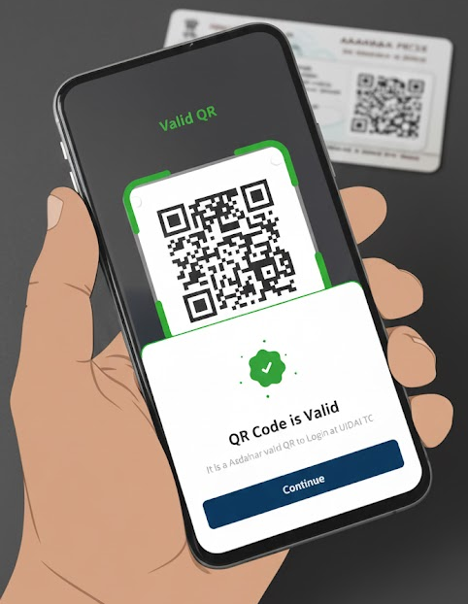
Use Case 05
Scan the QR code in physical Aadhaar card and know whether it is a real card.
A Platform
Show Aadhaar Card
Verify against Fake Aadhaar
Verified Identity

Slide 26

























Some Key OVSEs
Notes:
l

Slide 27



A Platform
Why onboard as an OVSE?
Flexible verification of Aadhaar Data
Reduce compliance burden
Quick and Seamless integration
Proof of presence, even offline
Improved operational efficiency and lower costs
Secure offline verification with savable output
Notes:
l

Slide 28





A Platform
The Gamechanger Policy!
Apply > UIDAI Verifies > Go Live
Apply for OVSE Registration
UIDAI verifies the details
Application is processed for Approval
Registration Certificate (valid for 2 years) issued post approval
OVSE initiates integration with help from UIDAI tech team
Send your applications to ovse.registration@uidai.net.in
Notes:
l

Slide 29
No platform evolves alone.
The next breakthrough in India's identity stack
will come from someone in this room.
Notes:
l

Slide 30
SITAA: India's open innovation engine for ID Tech.
SITAA
A strategic initiative by UIDAI to co-create the future of identity with startups, industry, and academia.
India's ID tech ecosystem is fragmented — innovation happens in silos
Technology is evolving faster than any single organisation can track
The problems ahead; Deepfake liveness, contactless biometrics, offline credentials — need the best minds in the country
UIDAI has the infrastructure.
You have the innovation.
Funding
Up to ₹2.5 Cr for Startups · Up to ₹5 Cr for Academia · Grant-based, output-linked
Co-creation
Co-develop with UIDAI engineers · Co-funding arrangements available · Access to live infrastructure guidance
Pilot Dev Support
Test within UIDAI's environment · No Cost. No Commitment. · Real data, controlled sandbox access
Core Focus Areas
Notes:
l

Slide 31
ID'athon: SITAA's innovation in action.
SITAA
Verifiable Credentials ID'athon
Data Hackathon
Two tracks.
Thousands of applicants.
Real problems.
Real stakes.
for Students & Academia
for Startups and Industry
160+
5300+
Applications
Applications
6
5
Teams Shortlisted
Teams Shortlisted
₹10 Lakhs
₹5 Lakh
Prize Pool
Prize Pool
Notes:
l

Slide 32
Aadhaar Sandbox: your playground.
SITAA
What you can do today?
What's coming?
The Roadmap
Test, validate, and fail fast — before touching live systems.
eKYC Workflow Validation
Digital Identity Wallet Integration
A risk-free environment enabling organisations to build, test, and refine Aadhaar-based digital identity solutions without impacting live production systems. No AUA licence needed to get started.
Integration
Run end-to-end KYC pipelines in a sandboxed replica before deploying to production.
Native wallet support for Aadhaar -linked verifiable credentials
Aadhaar Login Integration
Touch-less Biometric SDK
Build and test OAuth-based Aadhaar Login flows with simulated user data.
Contactless fingerprint and iris capture — built for modern devices
Multi-modal Auth Testing
AI Deepfake & Liveness Detection
Validate fingerprint, iris, face, and OTP authentication in combination — simultaneously.
Advanced presentation attack detection — challenge open to academia too
Notes:
l

Slide 33
Collaborative networks of academic institutions working to build India's next-gen identity technology stack
SITAA
Create Awareness
Build understanding of ID-Tech across campuses — what Aadhaar is, how verifiable credentials work, what's being built at the frontier.
Enable Research & Development
Active experimentation at campus level. Access to Sandbox, open datasets, and SITAA challenges. From final-year projects to PhD theses.
Students
Research Scholars
Faculty
Build a Talent Pipeline
A sustained pool of engineers, researchers, and designers who understand identity infrastructure — that industry and government can hire and collaborate with.
ID-Tech Communities: innovators from the campus
ID-Tech Roundtable
A focused roundtable under the theme: “Innovation in Identity Technologies — Emerging Research, Use Cases, and Future Directions.” Bringing together ID-Tech, Cybersecurity, and AI researchers across institutions.
Notes:
1. Score Consistency / Stability
Measure how stable the matching score is for the same user across:
Multiple captures
Different sessions
Device variations
👉 Detects SDKs that are “accurate but noisy”
2. Intra-class Variance (Same User Variability)
Evaluate how much the score fluctuates for genuine matches
Lower variance = more reliable SDK
3. Threshold Sensitivity Analysis
Test how performance changes across thresholds
How sharply does FNMR increase?
Is there a stable operating band?
👉 Helps in real-world threshold tuning
4. Template Aging / Time Robustness
Run same-match comparisons across:
Time gaps (days / months)
Different capture conditions
👉 Measures long-term reliability
5. Cross-device Consistency
Same user matched across:
Different OEM cameras
Sensor quality variations
👉 Critical for Aadhaar’s heterogeneous device ecosystem
6. Environmental Robustness
Same-match under:
Low light
Motion blur
Occlusion
👉 Moves closer to real deployment conditions
7. Failure-to-Acquire vs Match Quality Correlation
Check:
Does SDK fail capture often but give high scores when it works?
Or consistent capture + moderate scores?
👉 Helps identify usability vs accuracy tradeoffs
8. Score Calibration / Interpretability
Evaluate whether:
Score distributions are well separated
Scores are comparable across SDKs
👉 Important for ecosystem-level standardization

Slide 34
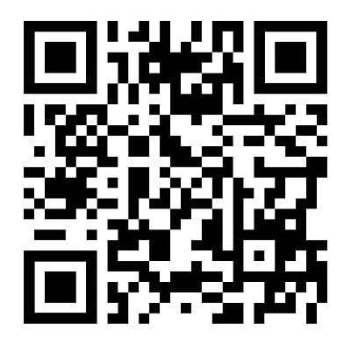
Thank
You!
Download the Aadhaar App
Explore SITAA
sitaa.uidai.gov.in
Access Aadhaar Sandbox
sandbox.uidai.gov.in
Notes:
l

